Slide 2
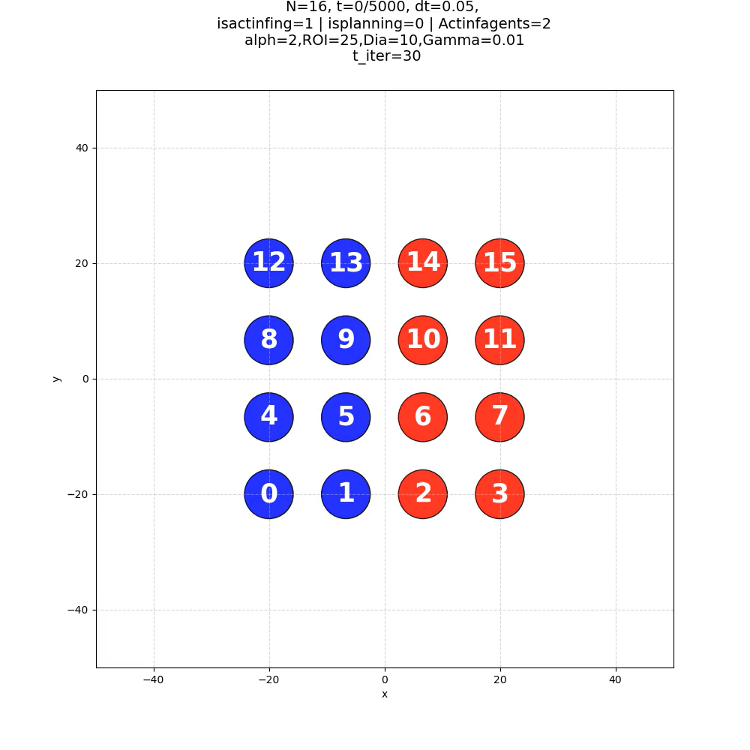
Agents starting from symmetric configuration, no planning, single step active, ignore 2 in heading

Slide 3
Parameters That are constant unless specified otherwise
S=120x120 (half of the side length of the initial condition square)
Dia=10 ()
Dt=0.01
S0=1
Eta=pi and 0
Alpha = 2 #For restitution force
ROI=Dia+2
Gamma = 1 #for repulsion force
Bounds on d, 5%, 30%,

Slide 4
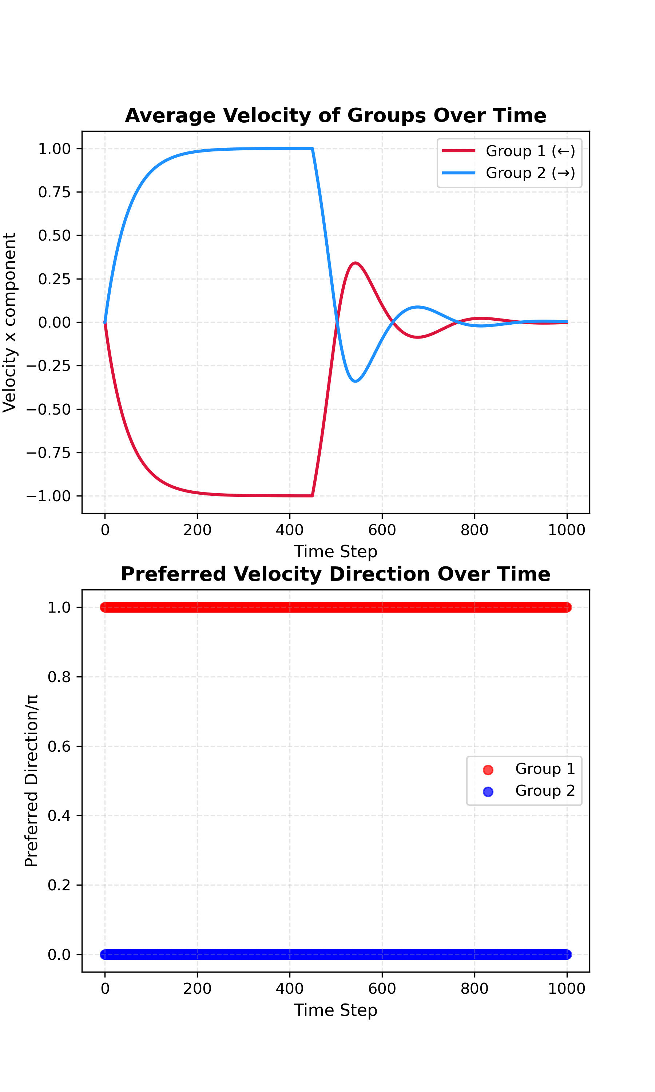
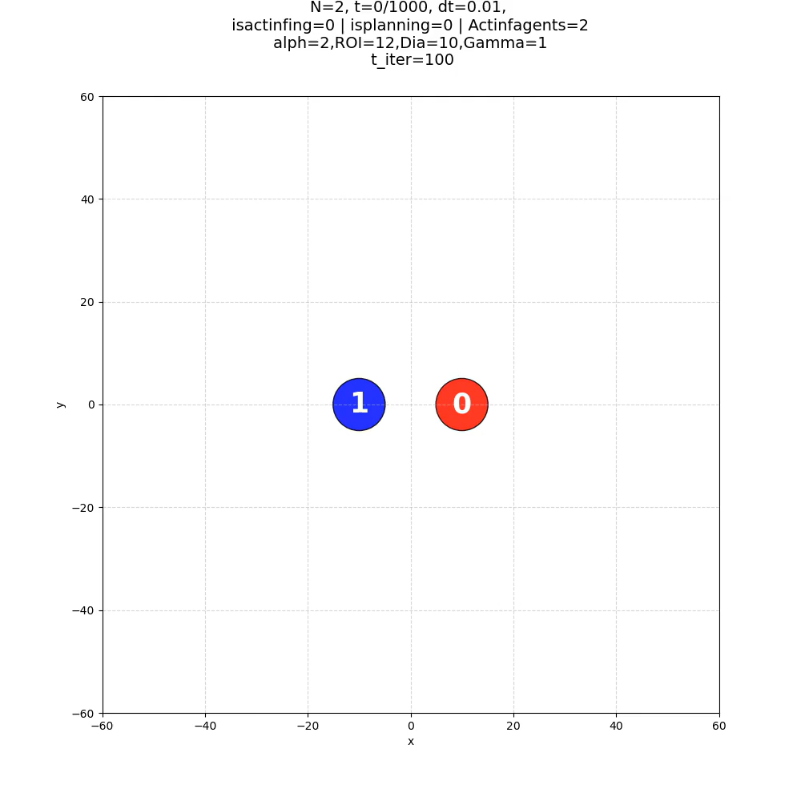
N=2, no noise, no active inference

Slide 5
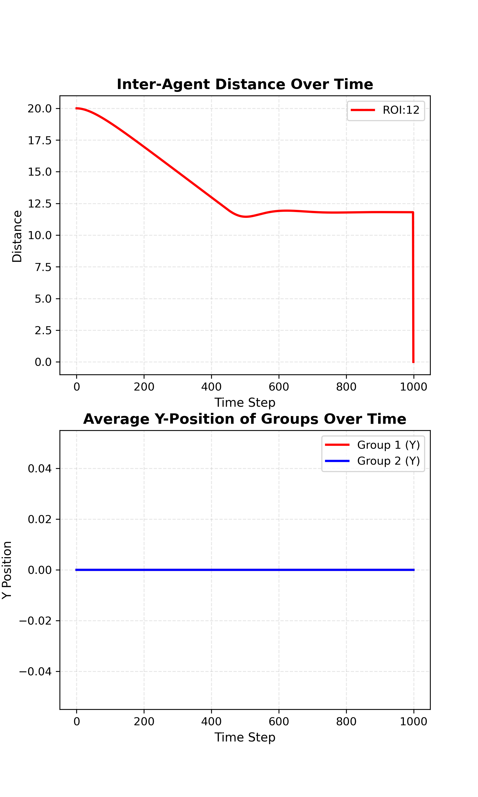
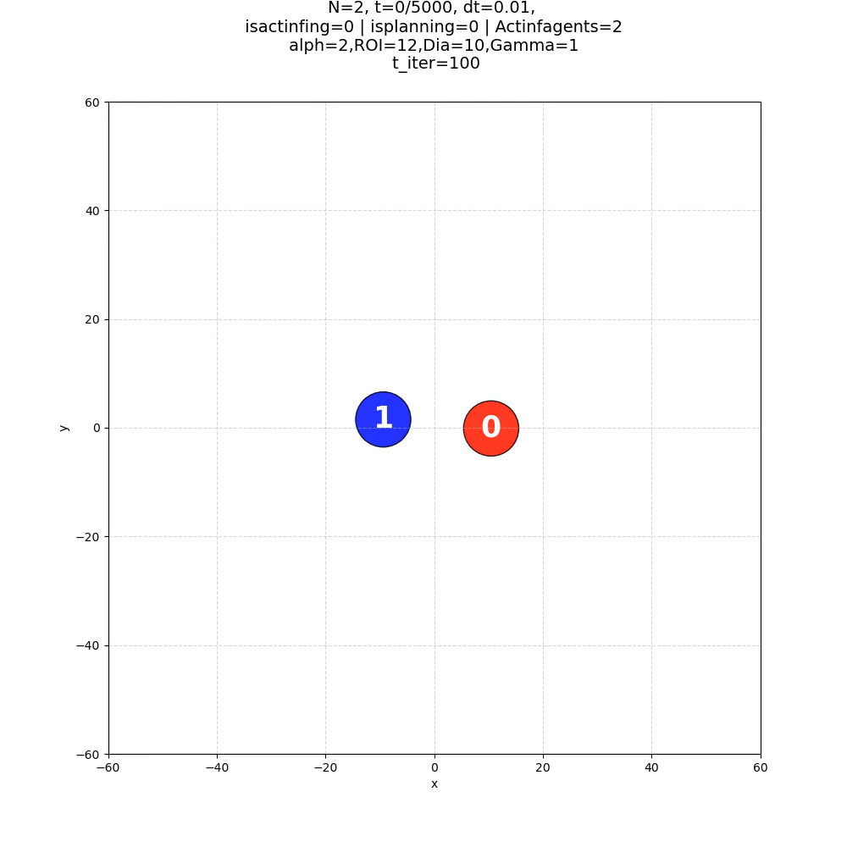
N=2, noise, no active inference

Slide 6
N=2, No Noise, Active Inference

Slide 7
N=2, Noise Active Inference, T_iter=1

Slide 8
N=2, Noise, Active Inference, t_iter=large and good

Slide 9
N=16, Noise, No Active Inference

Slide 10
N=16, noise, Active inference

